Slide 1

FLEET COMPANY CARS COMMUNICATION PLATFORM

Slide 2
What is it...
A system of communication tools and media for the information and business support of fleet management.

Slide 3
The platform includes
Print media
Internet media
Events
Opinion polls

Slide 4
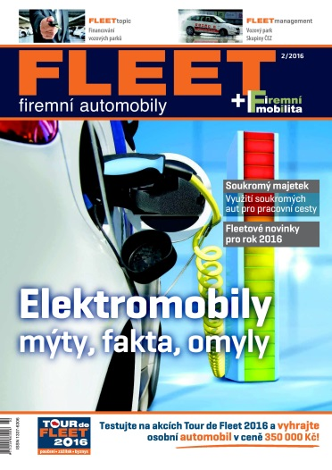
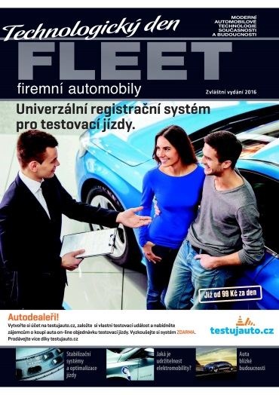
Print media
FLEET Company Cars (since 2004)
FLEET monothematic issues (since 2010)
FLEET nomination supplement (since 2008)
FLEET Best Of... (since 2010)

Slide 5
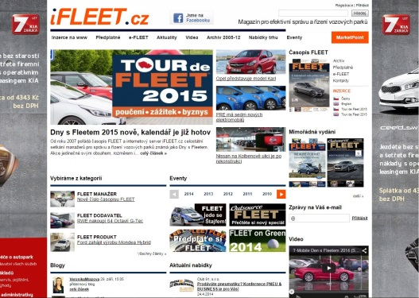
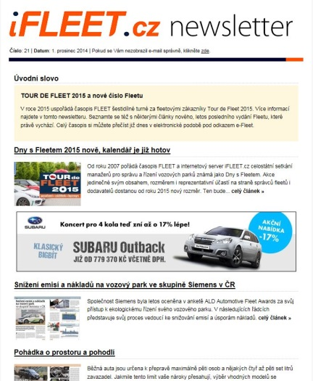
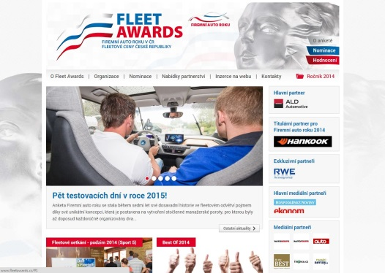
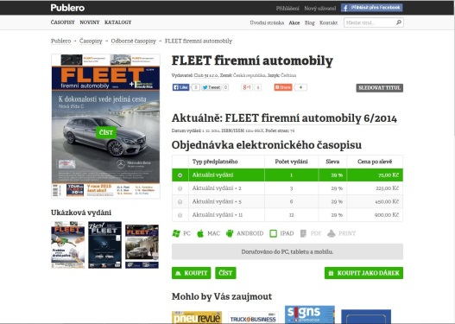
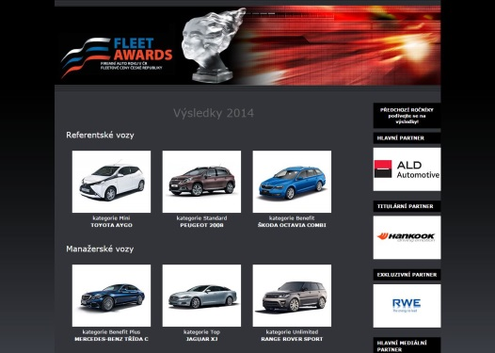
Internet media
www.iFLEET.cz
www.Fleetawards.cz
www.Firemniautoroku.cz
Electronic newsletters
e-FLEET (alza.cz/media)

Slide 6






Events
Fleet Days (since 2007)
Tour de Fleet (beginning 2015)
Fleet Festival and Fleet Gala (beginning 2015)
Special events (Fleet Monday at Autoshow, CNG Tour etc.)
→ for more information see the Tour de Fleet 2017 presentation

Slide 7


Opinion polls
ALD Automotive Fleet Awards (since 2008)
Company Car of the Year (since 2008) and Hankook Company Car of the Year (since 2014)
→ for more nformation see the Fleet Awards 2017 presentation

Slide 8
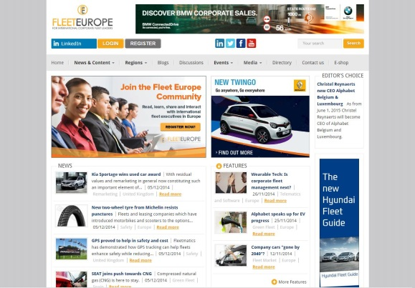
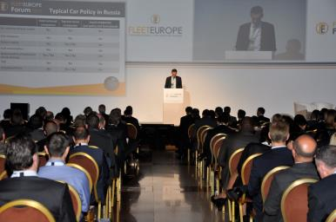
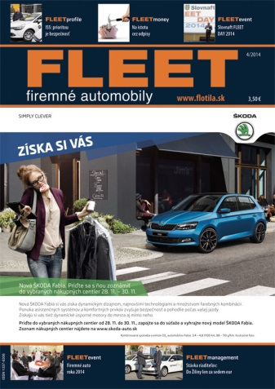
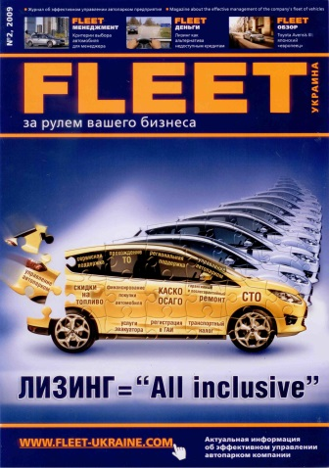
International cooperation
FLEET firemné automobily (SK)-joint venture
Fleet Europe (B)
Fleet Europe Forum (B)
FLEET Ukraine (UA)

Slide 9
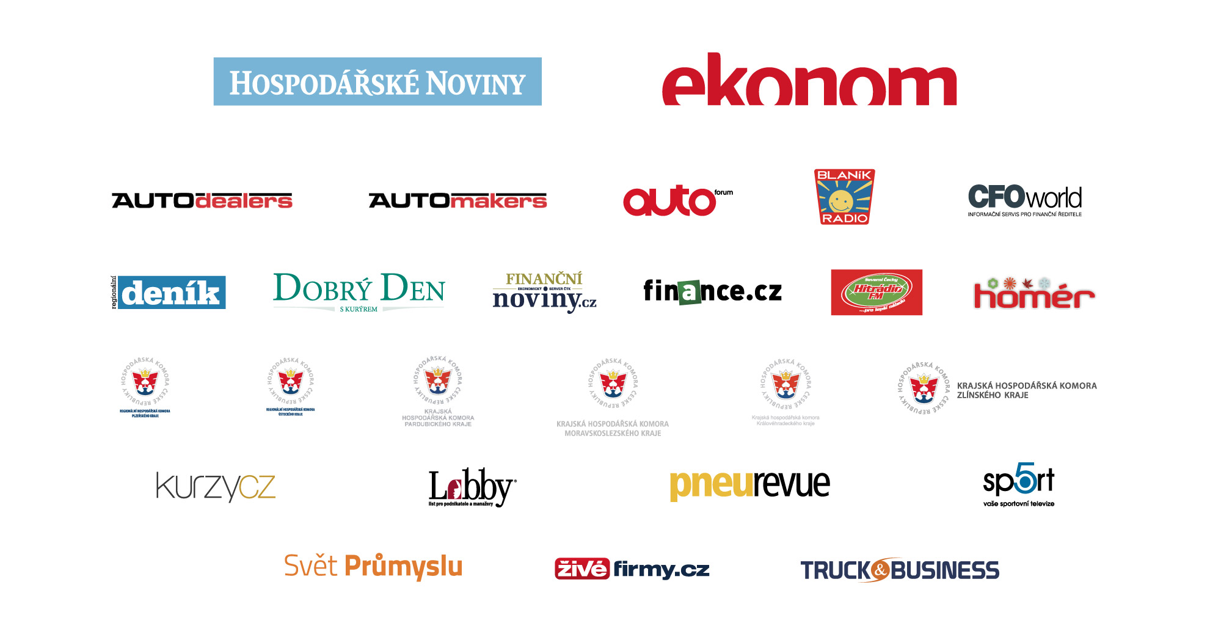
Media partners

Slide 10
Business cooperation
The FLEET communication platform represents a diverse and comprehensive tool for marketing and business support.
Print advertising
On-line advertising
Public Relations
Advertorials
Event partnership

Slide 11
No. 1 in FLEET
Expertise
Tradition
Diversity
Consistency
Innovation
OUR FLEET MANAGERS UNDERSTAND US!

Slide 12
Thank you for your attention.
We are looking forward to working together!
FLEET|TEAM

