Slide 1

PNEU REVUE
COMMUNICATION PLATFORM

Slide 2
What is it...
A system of communication tools and media for the information and business support of the area of tyre sales, tyre fitting and the automotive aftermarket.

Slide 3
The platform includes
“Pneu Revue” magazine
Internet media
Events

Slide 4




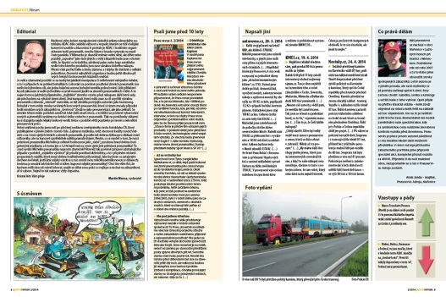
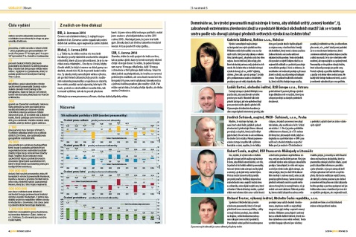
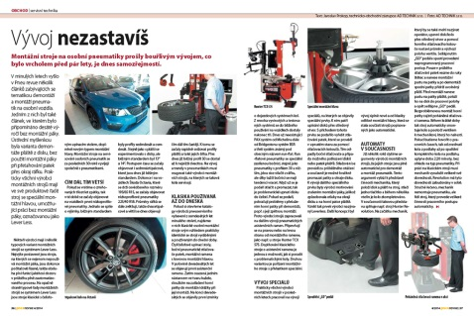
PNEU REVUE magazine
Since 1995
“Mirror” of the industry
Opinion maker
All target groups: tyre fitters, managers, company owners, customers, etc
Clear impact on the modern history of the sector

Slide 5
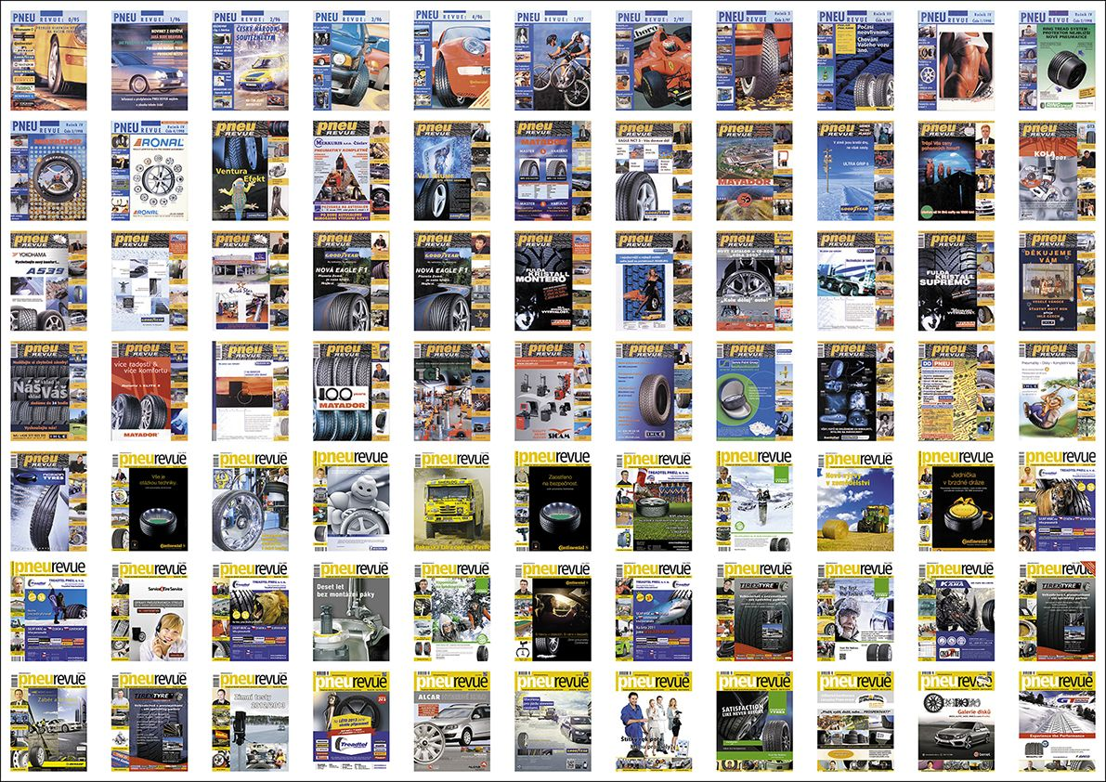

Slide 6
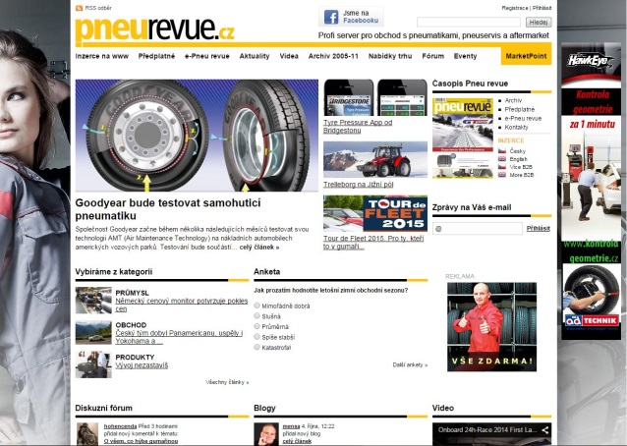
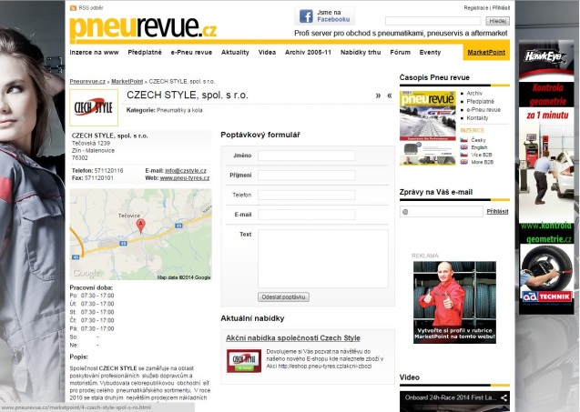
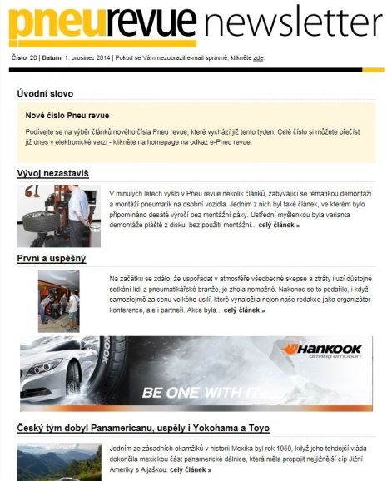
Internet media
www.pneurevue.cz
The other “pillar” of the communication platform since 1999
Rich editorial content
Discussion forums and blogs
“MarketPoint” business communication tool
Electronic newsletters
15 - 20 per year
Strong target group
Attracting an additional audience beyond the print magazine

Slide 7
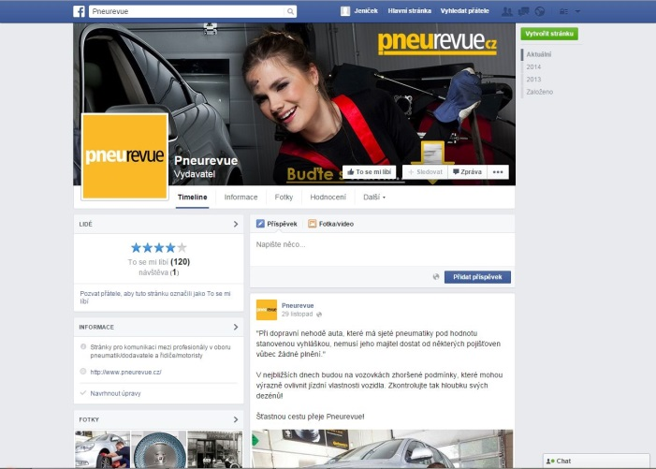
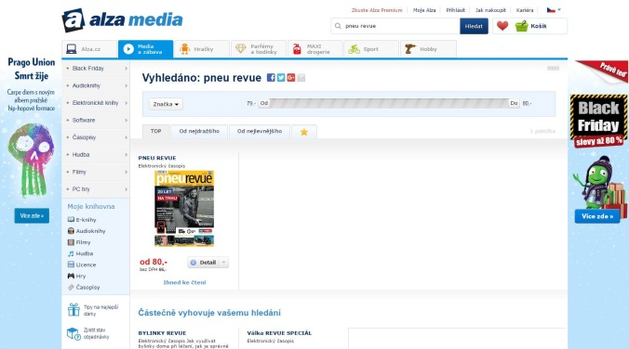
Internet media
Social networks
Facebook profile targeting additional groups
(tyre users)
Alza.cz
Electronic version of the print magazine on Alza.cz/media

Slide 8
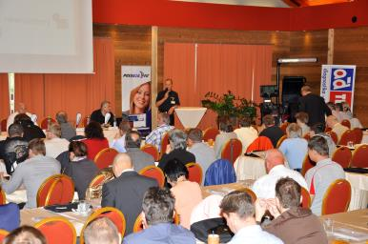
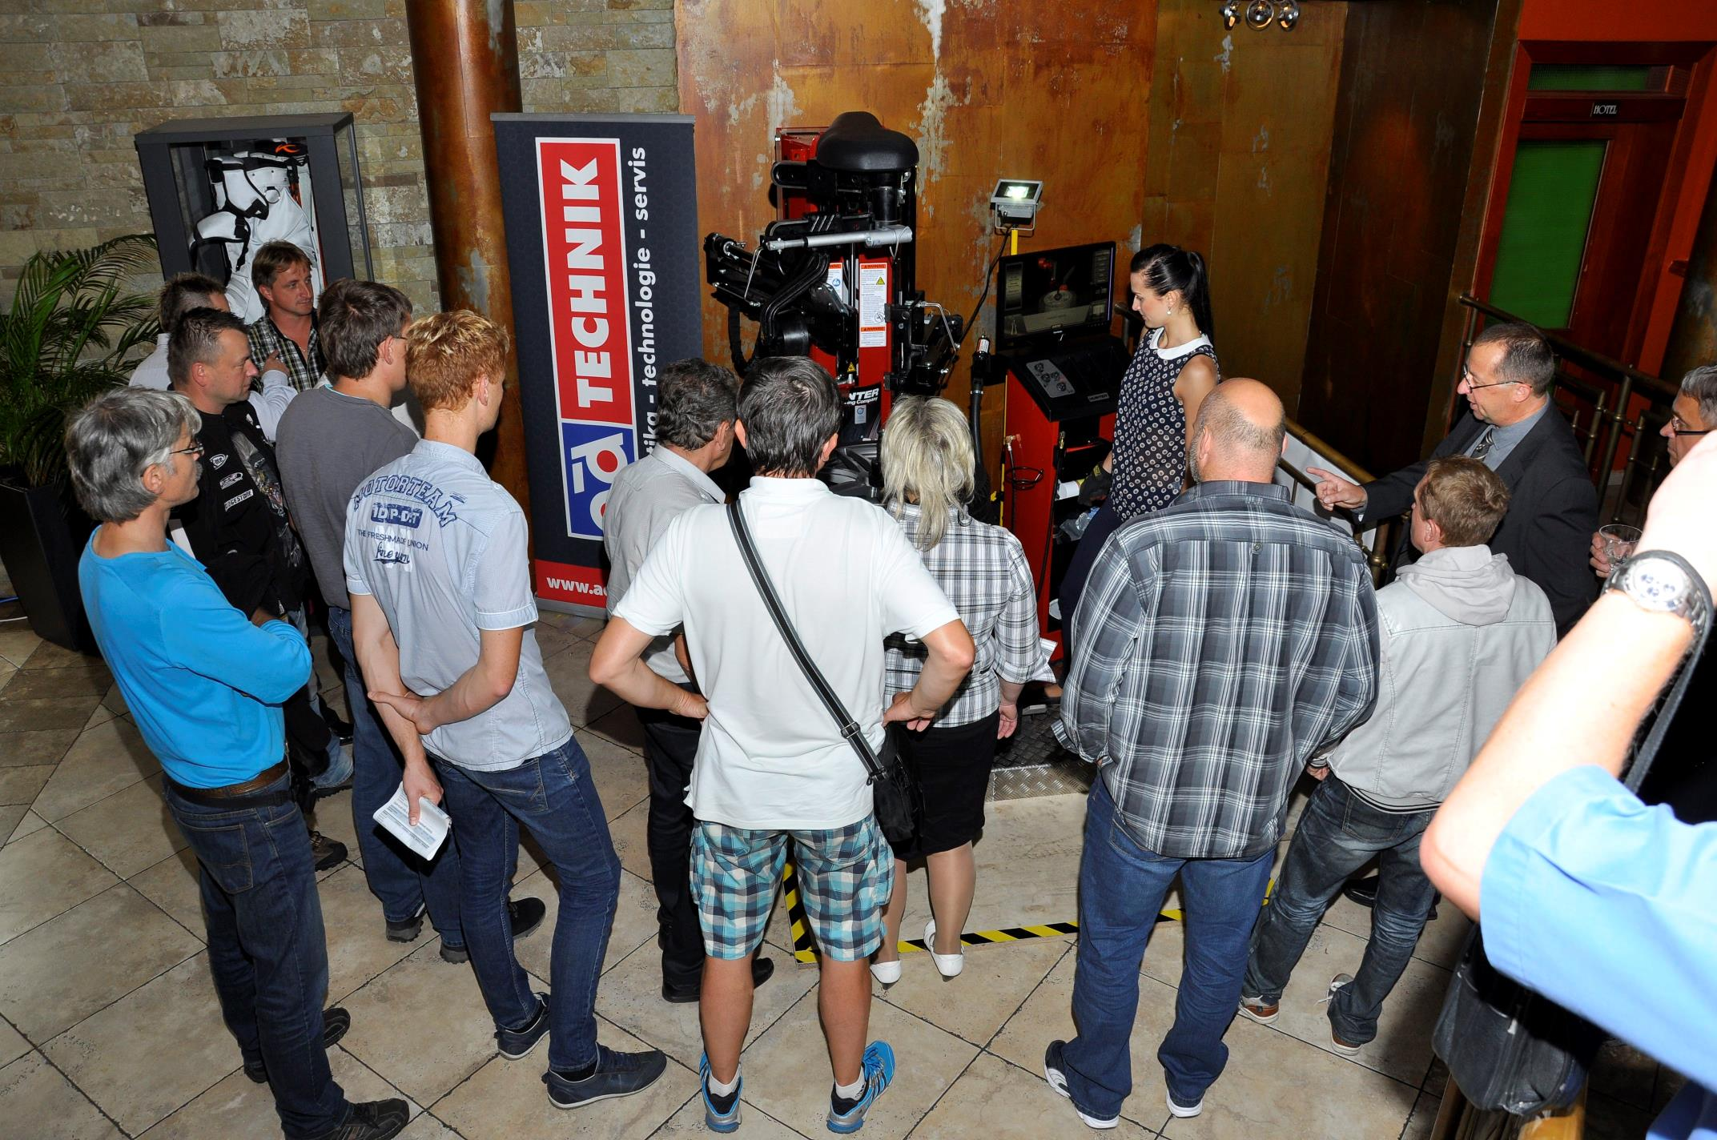
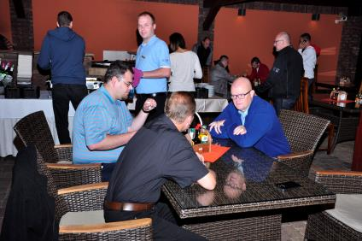
Events
“PNEU & BUSINESS” business conference
Prestigeous forum of the industry
170 participants
14 top speakers
On-line streaming
Full archive on www.pneurevue.cz/eventy

Slide 9


International cooperation
Shina plus (Ukraine) - since 2003
Full Slovak edition since 2014
Editorial cooperation (Neue Reifenzeitung, Tyres & Accessories and others)

Slide 10
Business cooperation
PNEU REVUE communication platform represents a diverse and comprehensive tool for marketing and business support.
Print advertising
On-line advertising
Public Relations
Advertorials
Event partnership

Slide 11
Summary
Why have they been reading us for more then 20 years?
Expertise
Tradition
Range
Consistency
Innovation

Slide 12
Thank you for your attention
We are looking forward to working together!
PNEU REVUE|TEAM

