Slide 1


The 2017 ALD Automotive Fleet Awards and
The 2017 Hankook Company Cars of the Year
10th Edition

Slide 2


What is it...
A nationwide contest whose aim is to acknowledge and reward excellent personalities, products and services in the sector of car fleet management.

Slide 3
The Fleet Awards (FA) include...
Company Car of the Year (CCY) in 9 categories as voted by a jury consisting of 100 managers of 100 Czech companies
Company Car of the Year decided by internet voters
Fleet Awards in 6 categories
The Fleet Manager of the Year (from the point of view of fleet operator and fleet supplier)

Slide 4
Voting systems
100 managers of 100 Czech companies vote for the Hankook Company Car of the Year in the main category; the jury is nominated by the editor-in-chief of FLEET magazine
Internet voting for the Hankook Company Car of the Year supported by media Partners and participating Companies (Partners) is open to the public
The Fleet Awards in other categories are decided by a panel of experts consisting of 10 members
For more information please refer to the General Terms at
http://www.fleetawards.cz/organizace/vseobecne-podminky/

Slide 5
2017 Time Schedule
1. 3. 2017 Official launch, nomination form for Fleet Awards available
31. 3. 2017 Nomination deadline for 2017 Company Car of the Year
14. 4. 2017 Deadline for information file submission to the “100 jury” members
20. 4. 2017 Fleet Day - Brno
15. 6. 2017 Fleet Day - Most
14. 9. 2017 Fleet Day - Pardubice
22. 9. 2017 Nomination deadline for 2016 Fleet Awards
25. 9. 2017 Deadline for results from “100 jury” members
27. 9. 2017 “10 jury” meeting, presentation of nominations (Prague)
19. 10. 2017 Prize giving Ceremony, gala dinner (Prague)
Fleet Day - Staré Město

Slide 6
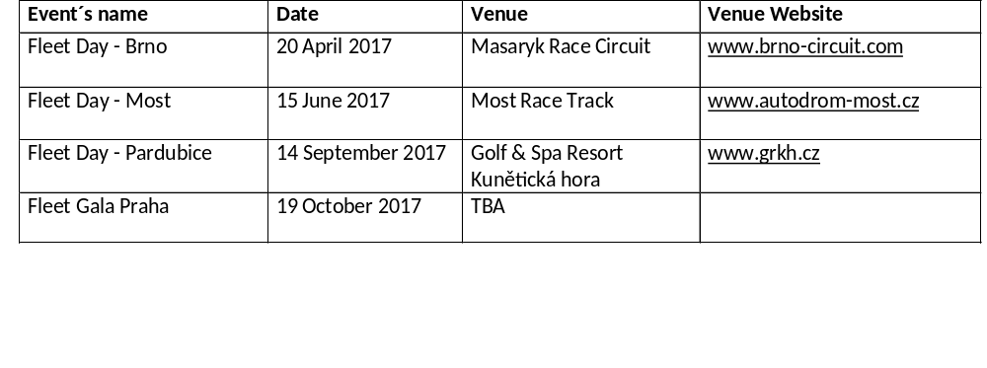
2017 Fleet Days: Overview
For more information on event venues please refer to the 2017 Tour de Fleet presentation.

Slide 7
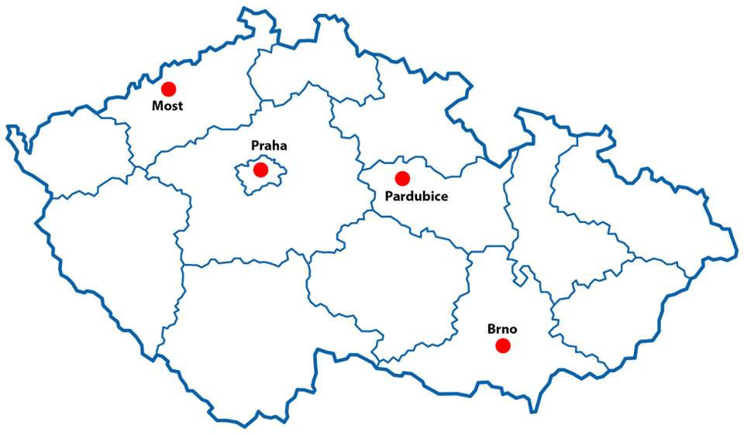
2017 Test Events: Map
Subject to change due to organizational reasons

Slide 8


Fleet Gala 2017
The prize giving ceremony will take place at the 2017 Fleet Festival Event (Fleet Show & Conference) in Prague (19. October 2017).

Slide 9
Partnership
Partnership in the annual Fleet Awards contest represents a unique marketing opportunity for all those who deliver products and services to car fleets and wish to attract potential new customers and strengthen their image and reputation as modern fleet suppliers.

Slide 10
Why become a Partner?
You acquire valuable new business contacts at the accompanying fleet events
You are updated on the latest advancements and trends essential for your decision making and planning
You benefit from a large audience of potential clients and business associates at the events and media coverage
You associate your name with a respectable, high-profile and well organized event
You get free publicity while presenting the contest in the FLEET magazine and partnering media publications
You strengthen your image as a premium fleet partner

Slide 11
Partnership Models
3 partnership levels (Gold, Silver and Bronze) + Honorary Partner for Company Car of the Year (CCY)
Gold Partner and Honorary Partner for CCY no longer available for 2017 (sold out)
Further partnership levels non-exclusive
Car manufacturers not eligible for FA and/or CCY partnership
Please request price offer.
Please request price offer also for Fleet Festival and Fleet Gala 2017.

Slide 12

Media Partners

Slide 13
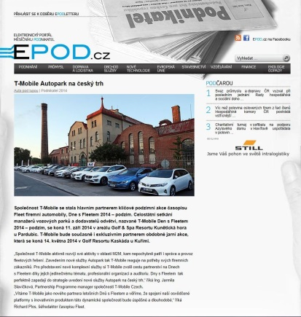
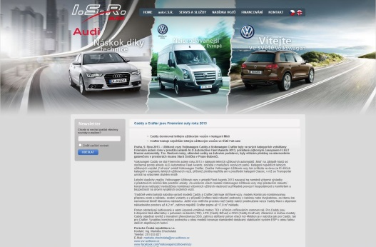
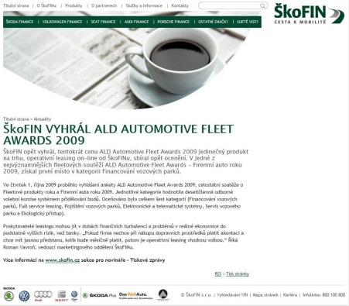
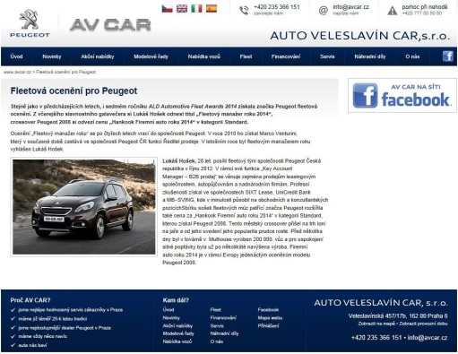
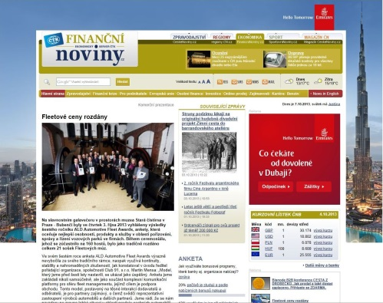
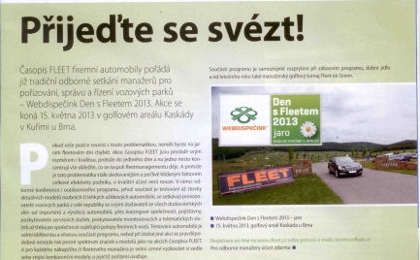
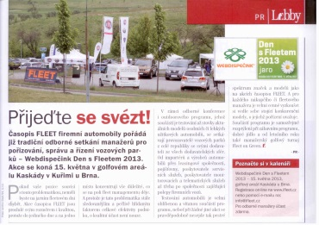
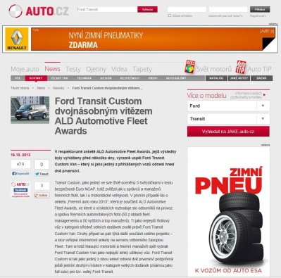
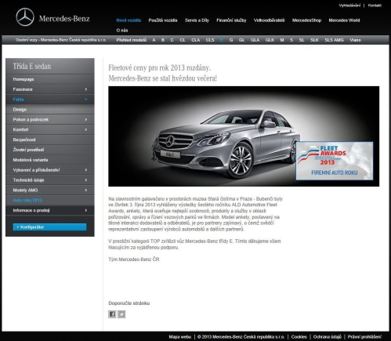
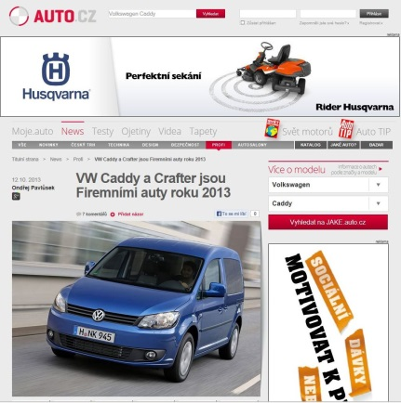
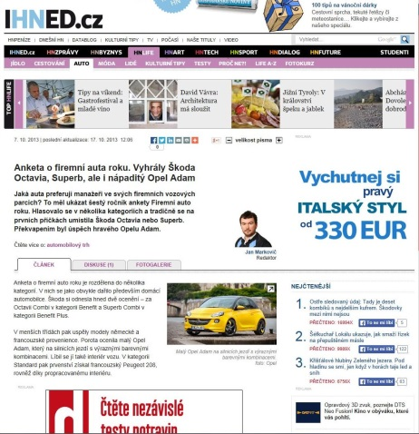
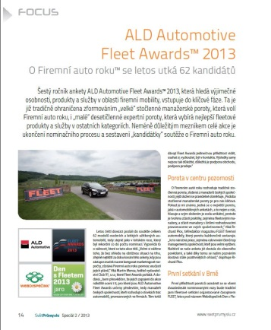
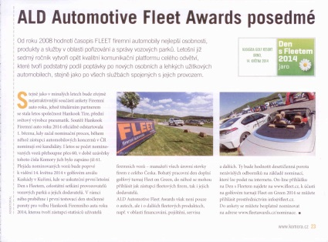
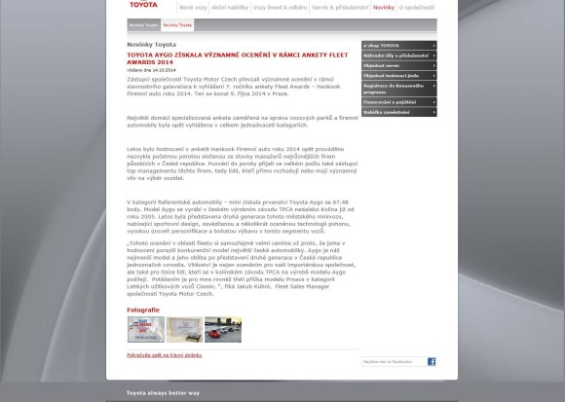
Rich media coverage

Slide 14
We are driven by expertise, experience and tradition
“FLEET company cars” magazine (13 years)
On-line (iFLEET.cz, Fleetawards.cz, Firemniautoroku.cz)
Electronic newsletters
Events (11 years)
International cooperation (partners with Fleet Europe and Fleet Europe Forum)
Established media base in Slovakia (magazine, online, events, awards...)

Slide 15
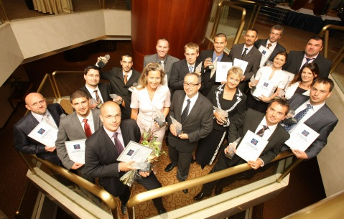
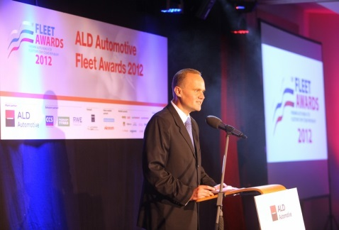
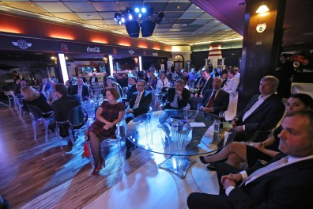
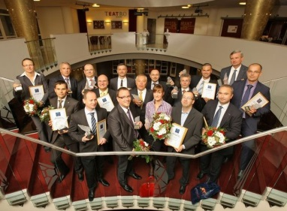

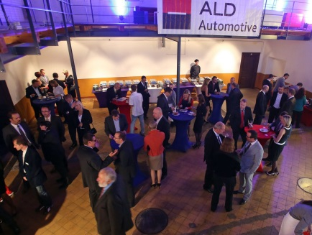
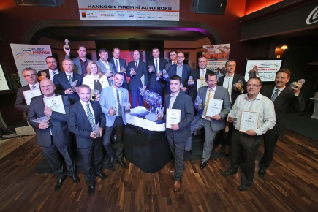
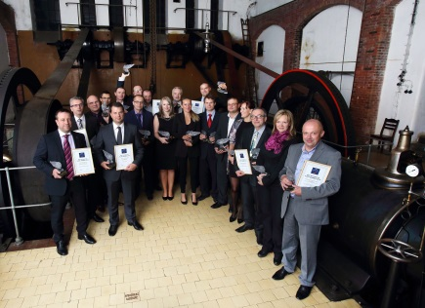
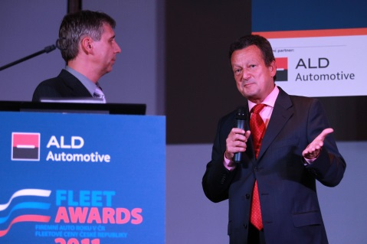

ALD Automotive Fleet Awards 2008 - 2016

Slide 16
Summary
We continue our successful tradition
More accompanying events = more business opportunities for all parties involved
Closer to the customers
Focus on quality
Active Partners warmly welcome (more involvement in the preparation process)

Slide 17
More information and a full history at
www.fleetawards.cz
www.firemniautoroku.cz

Slide 18


Slide 19
Join us for
The 2017 ALD Automotive Fleet Awards
and
The 2017 Hankook Company Car of the Year
We look forward to your cooperation!

