Slide 1


Slide 2

What is it...
Tour de Fleet 2017 is a nationwide tour of events in the Czech Republic aimed at the information and commercial support of the car fleet management sector.

Slide 3
Objectives
To establish a sustained platform for networking fleet management professionals with nationwide coverage
To establish a new “brand” for our fleet management communication activities

Slide 4
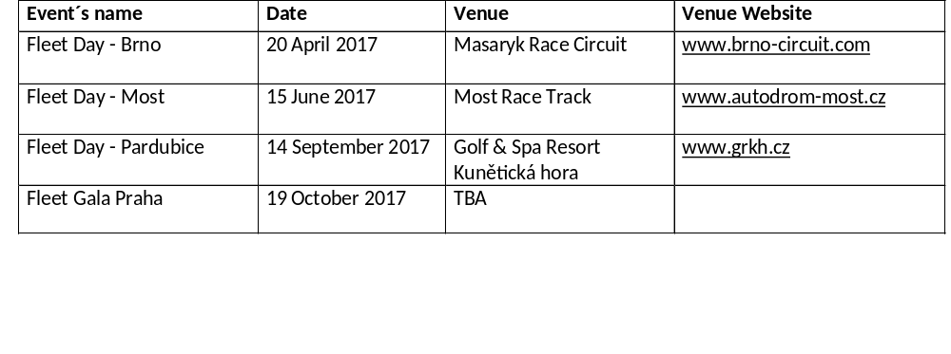
Tour de Fleet 2016 Calendar
Subject to change for organizational reasons

Slide 5
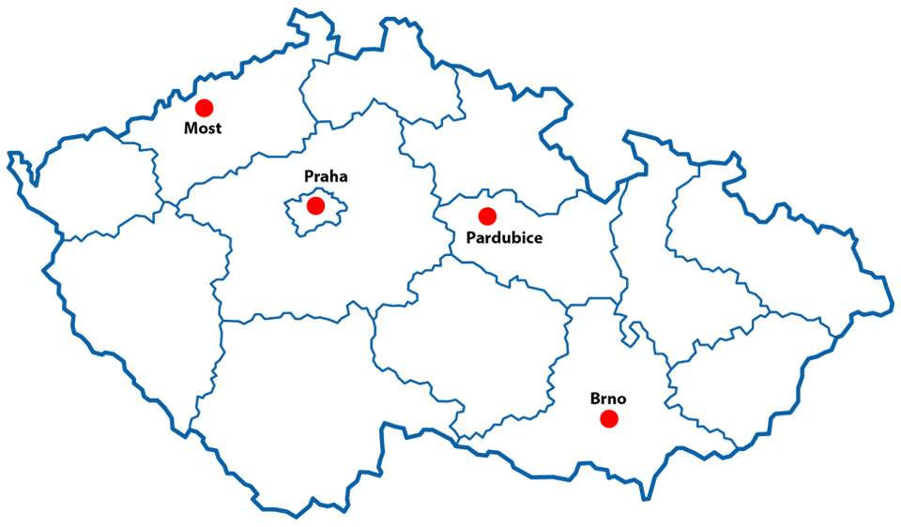
Tour de Fleet 2016 Map

Slide 6
Event Programme
Fleet Days:
Specialist presentations
Partner presentations
Workshops and micro-events
Fleet Festival & Fleet Gala 2017:
Fleet Village
Business Conference
Individual meetings and workshops at partner stands
Fleet Awards Evening prize-giving ceremony
Car testing
Business meetings

Slide 7

Tour de Fleet and 2017 Hankook Company Car of the Year
All Fleet Days are official test sessions of the jury for the vote of 2017 Hankook Company Car of the year.

Slide 8
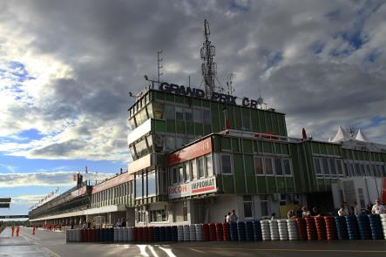
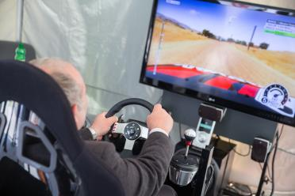
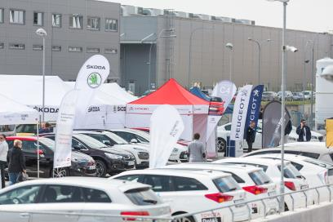
Fleet Day - Brno
Masaryk Race Circuit www.brno-circuit.com
The world-renowned Brno Race Track will host the Fleet Day for the second time - the first event was organized here back in June 2009. There are two major themes for the event: 2017 Preview of Car Novelties and Car Fleet Financing. As always, guests will enjoy the usual wide range of interesting presentations, workshops and of course personal testing of the most up-to-date passenger cars and LCV’s. The race track will provide the symbolic start of the 2017 Company Car of the Year contestwith all nominated cars performing two laps of honour around the famous European circuit.
Date of event: 20 April 2017 from 9:00am

Slide 9
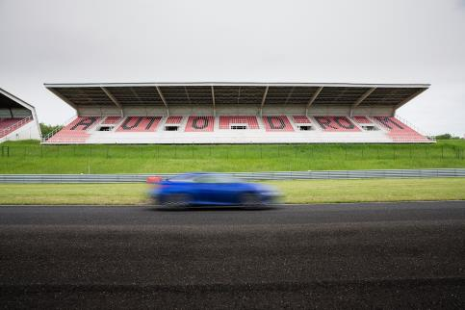
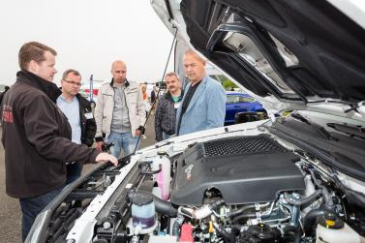
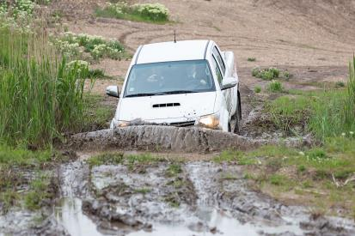
Fleet Day - Most
Most Race Track www.autodrom-most.cz
Another event, another international race track. The first two rounds of the 2017 Tour de Fleet take place on two famous motorsport circuits, the second being hosted at the Most Autodrom. Total cost of ownership and Fuel management, will be the hot topics of the day. The traditional test drives on the off-road track and the major tarmac racing circuit will as always be an eagerly anticipated component of the 2017 event.
Date of event: 15 June 2017 from 9:00am

Slide 10
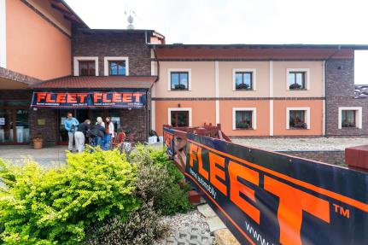
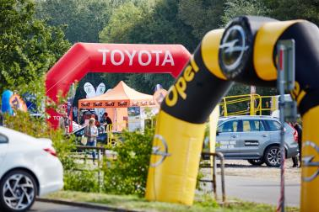
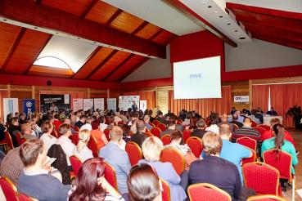
Fleet Day - Pardubice
Golf & Spa Resort Kunětická hora www.grkh.cz
The Golf & Spa Resort Kunětická hora in Eastern Bohemia is the longest serving venue for Fleet Days, annually hosting the event since its launch in 2009. The high quality indoor and outdoor premises provide the best environment for workshops, individual meetings and of course, car testing. No wonder the Fleet Day in Pardubice is one of the most popular among Czech fleet professionals. This year two special topics will continue this overall high standard: telematics in fleet management and modern car service. The event will also be the last testing opportunity for the jury members of the Company Car of the Year contest.
Date of event: 14 September 2016 from 9:00am

Slide 11
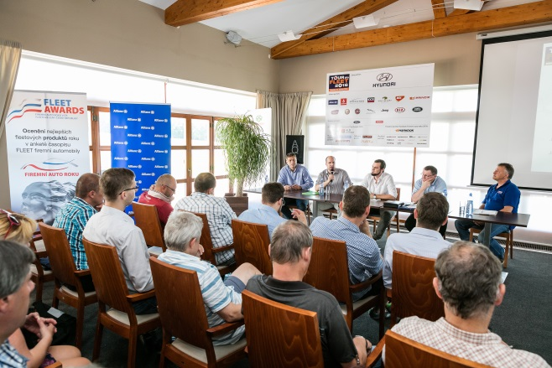
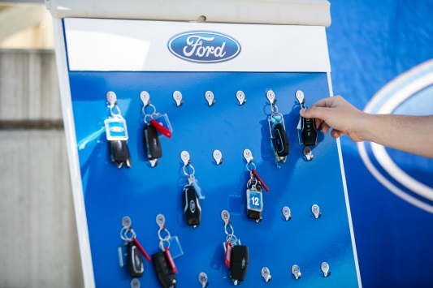
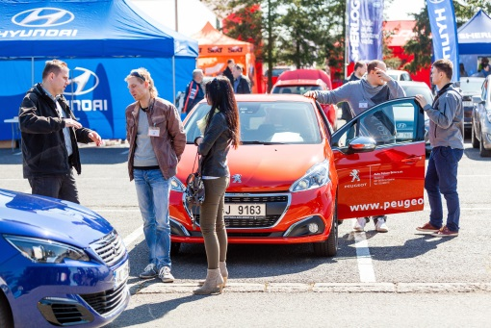
Fleet Day – Custom event
Usual Fleet Day make
Narážíte na to, že vnitřní předpisy některých společností již neumožňují zaměstnancům navštěvovat produktové či jiné firemní akce a prezentace? Nabízíme zorganizování individuální akce „na míru“ pro konkrétní dodavatelské firmy, jejich skupiny, akce zaměřené na specifické zákaznické skupiny apod. pod hlavičkou Tour de Fleet 2017.
Lze zorganizovat akci několika značek (joint promotion) se zaměřením na konkrétní zákaznickou skupinu (např. Bankovní Den s Fleetem, Energetický
Den s Fleetem apod.).
Zajistíme produkci od A do Z, elektronický registrační systém, on-line objednávky testovacích jízd, natočení dokumentárního filmu z akce v TV kvalitě, mediální pokrytí atd.

Slide 12


Fleet Festival & Fleet Gala - Prague
place to be confirmed
The introduction of the first Fleet Festival Praha in 2015 clearly showed its potential to become the leading meeting place for fleet business professionals in the country and a refreshing “counterweight” to the outdoor oriented Fleet Days. Business conference, fleet product & service indoor show and Fleet Awards and Company Car of the Year prize giving ceremonies - all in one! A unique indoor Fleet Village featuring fleet products and services, including cars, provides the best environment for business meetings, networking and opinion exchange. Follow the business conference with some of the country´s top presenters.
And join the gala evening where all the finest fleet products, services and of course fleet people will be recognised in the 10th edition of Czech ALD Automotive Fleet Awards!
Date of event: 19 October 2017

Slide 13
Partnership
Fleet days
3 partnership levels
Without exclusive items, but with the possibility of honorary partnership
Packages for 1, 2 or 3 events
Individual cooperation above the standard offer subject to negotiation
Customized invitation cards
Fleet Festival & Fleet Gala 2017
3 partnership levels
Without exclusive items, but with the possibility of honorary partnership
Show, conference and gala evening in one
Possibility of stand placement
Customized invitation cards
Please call us for quotations

Slide 14

Media partners / coverage

Slide 15
We are driven by expertise, experience and tradition
“FLEET Company Cars” magazine (13 years)
On-line (iFLEET.cz, Fleetawards.cz, Firemniautoroku.cz)
Electronic newsletters
Events (11 years)
Awards (10 years)
International cooperation (partners with Fleet Europe and Fleet Europe Forum)
Established media base in Slovakia (magazine, online, events, awards...)

Slide 16
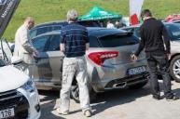
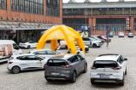
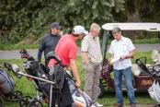
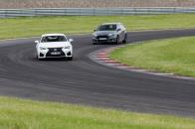
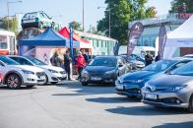
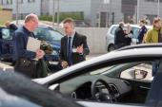
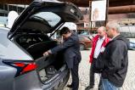
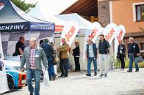

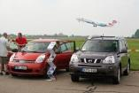
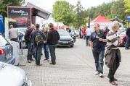
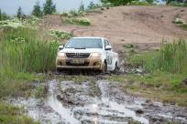
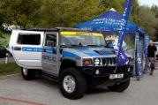
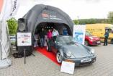
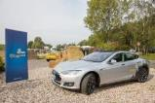
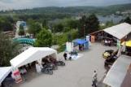
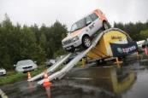
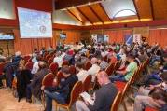
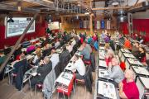
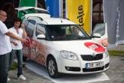

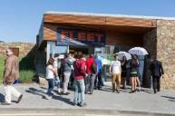
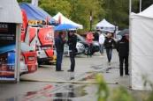
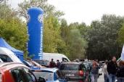
Events 2007 - 2016

Slide 17

Summary
We continue our successful tradition
More events = more business opportunities for all parties involved
Closer to the customers
Focus on quality
Active partners warmly welcomed (more involvement in the preparation process)

Slide 18
Follow us on the Tour de Fleet 2017
Looking forward to your participation!

